Slide 1
Spring Fundamentals
Kris Budé

Slide 2
Agenda
Introduction to Spring
Using Spring to configure an application
Understanding the bean life-cycle
Simplifying application configuration
Testing a Spring-based application
Annotation-based dependency injection

Slide 3
Goal of the Spring Framework
Provide comprehensive infrastructural support for developing enterprise Java™ applications
Spring deals with the plumbing
So you can focus on solving the domain problem
Core support
Application Configuration
Enterprise Integration
Testing
Data Access

Slide 4
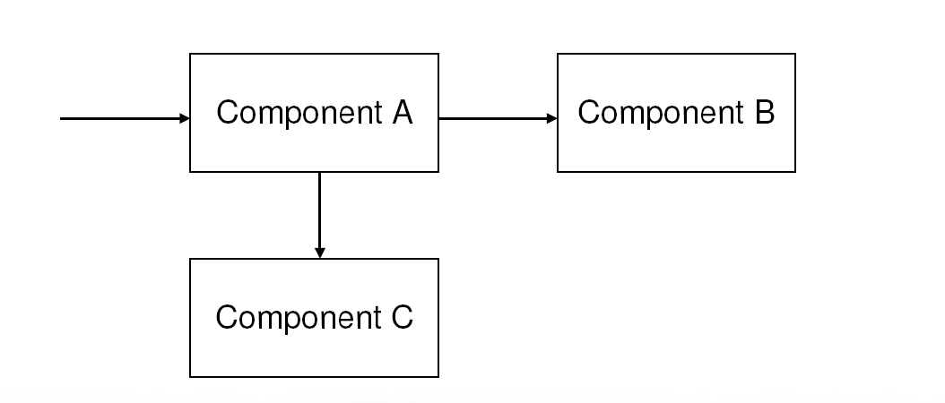
Application Configuration
A typical application system consists of several parts working together to carry out a use case

Slide 5
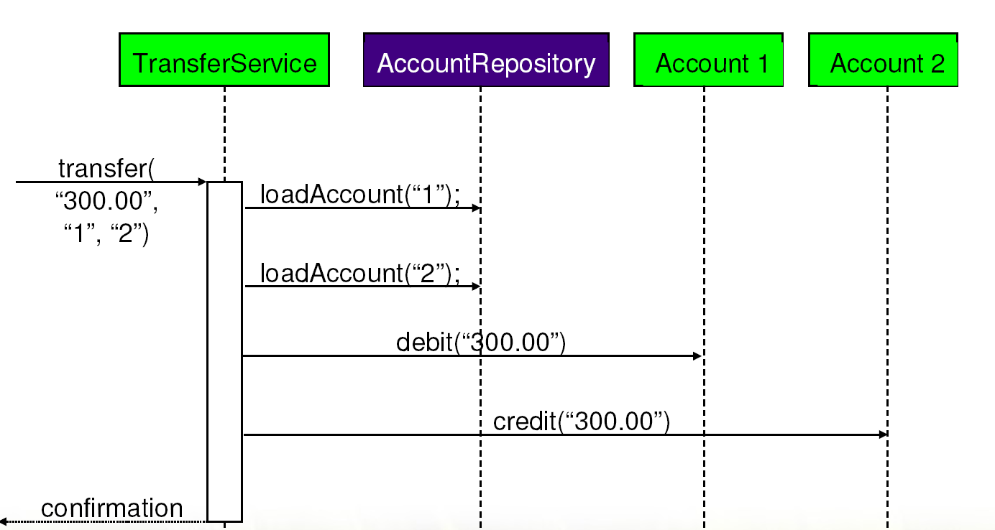
Example: A Money Transfer System

Slide 6
Spring’s Configuration Support
Spring provides support for assembling such an application system from its parts
Parts do not worry about finding each other
Any part can easily be swapped out

Slide 7
Enterprise Integration
Enterprise applications do not work in isolation
They require enterprise services and resources
Database Connection Pool
Database Transactions
Security
Messaging
Remote Access
Caching

Slide 8
Spring Enterprise Integration
Spring helps you integrate powerful enterprise services into your application
While keeping your application code simple and testable
Plugs into all Java EE™ application servers
While capable of standalone usage

Slide 9
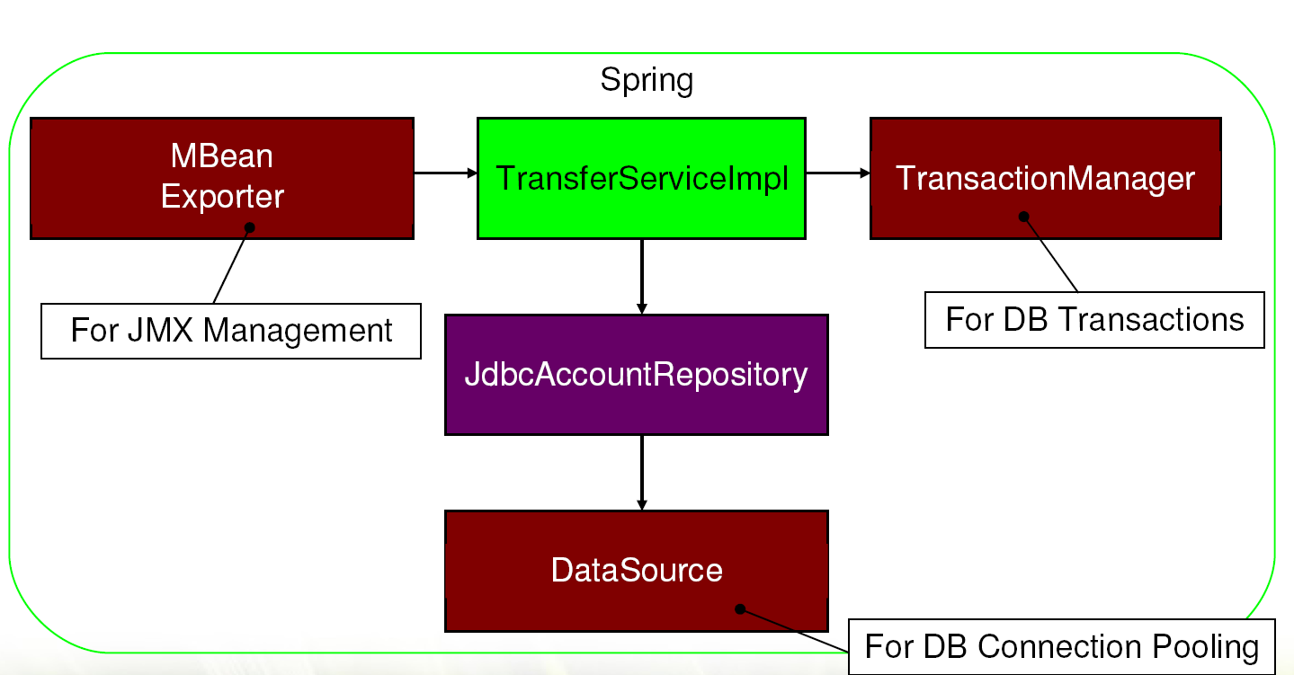
Enterprise Money Transfer with Spring

Slide 10
Spring Quick Start
Introducing the Spring Application Context and
Spring’s XML-based configuration language

Slide 11
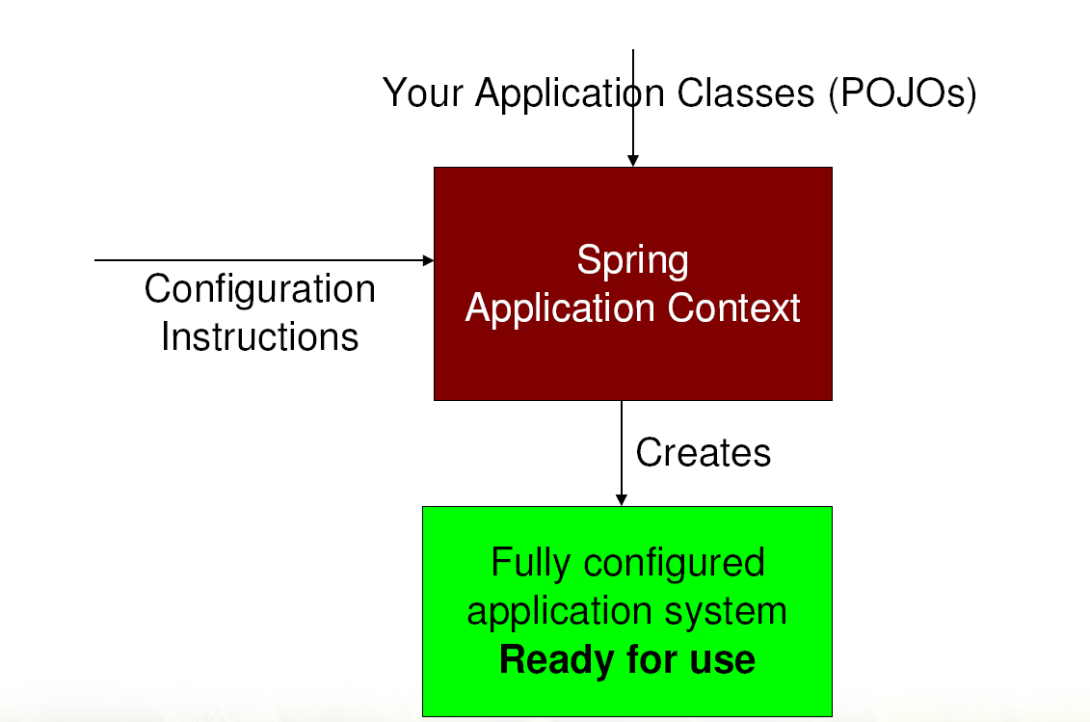
How Spring Works

Slide 12
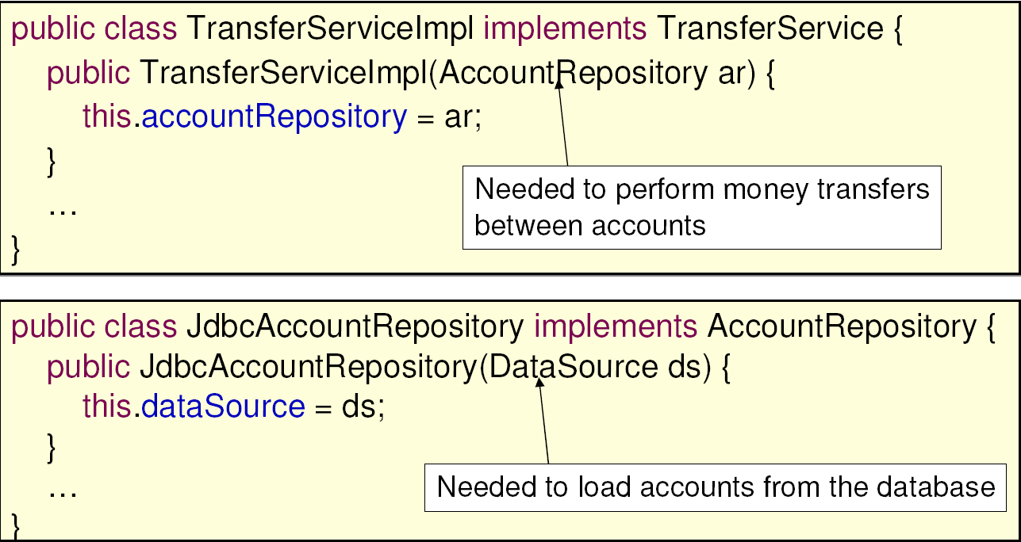
Your Application Classes

Slide 13
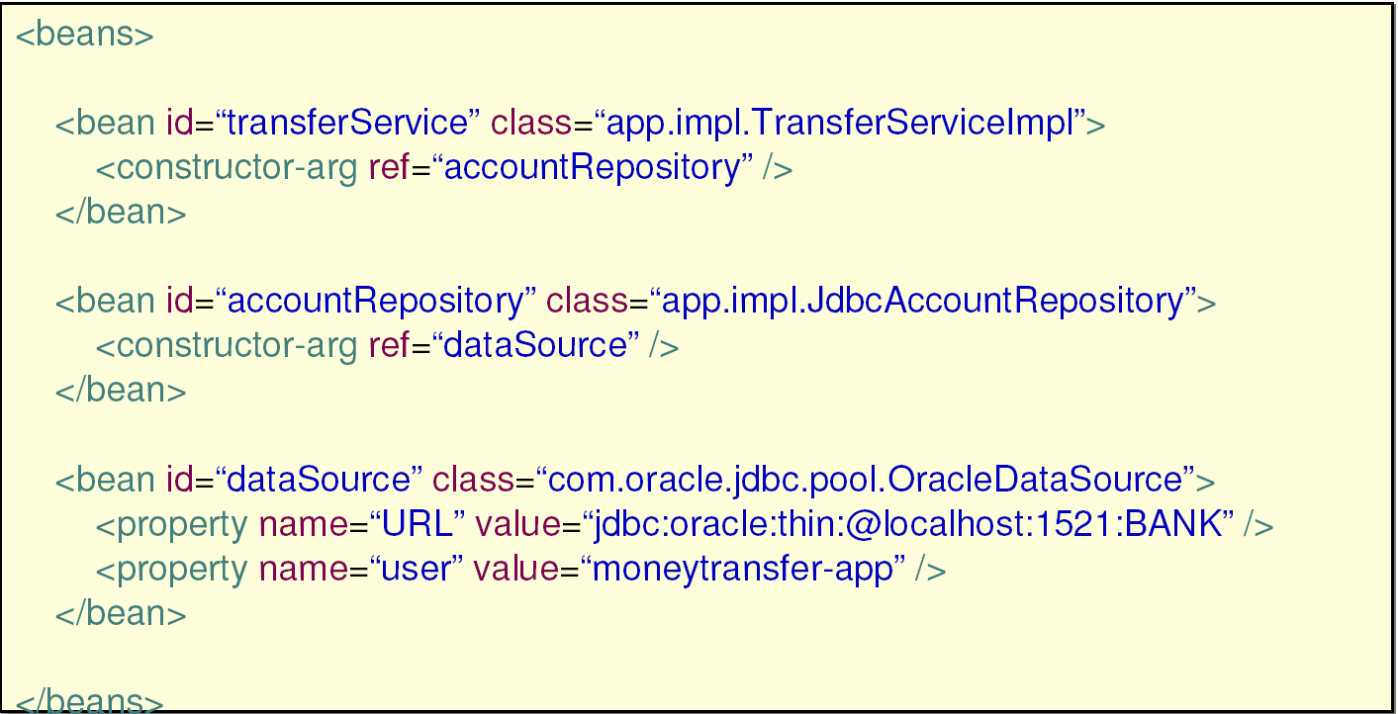
Configuration Instructions

Slide 14
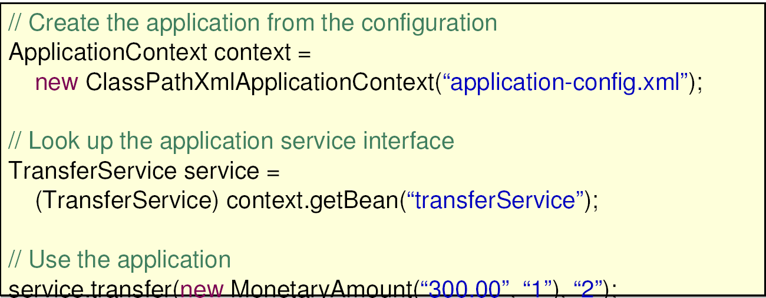
Creating and Using the Application

Slide 15
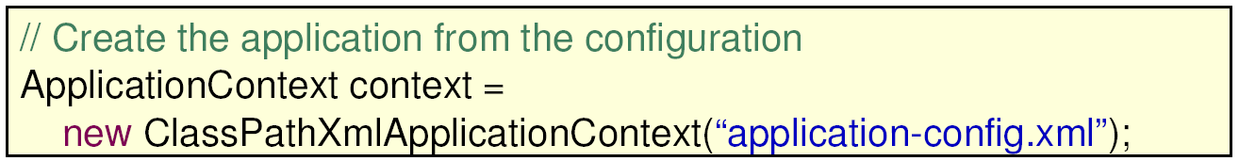
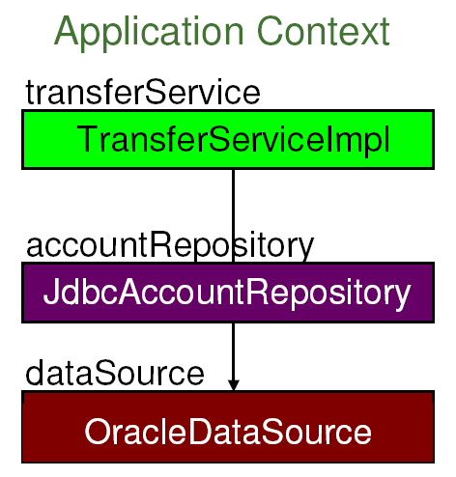
Inside the Spring Application Context

Slide 16
Quick Start Summary
Spring manages the lifecycle of the application
All beans are fully initialized before they are used
Beans are always created in the right order
Based on their dependencies
Each bean is bound to a unique id
The id reflects the service the bean provides to clients
Spring encapsulates the bean implementations chosen for a given application deployment
Conceals implementation details

Slide 17
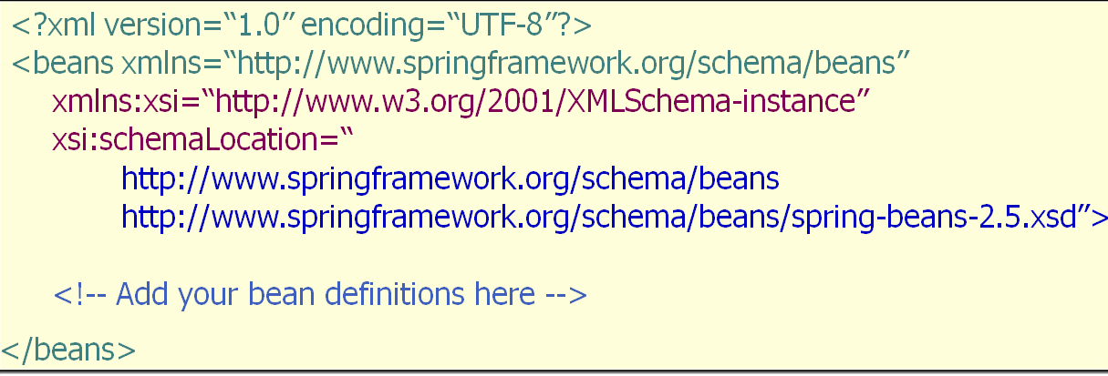
Basic XML Bean Definition Template

Slide 18
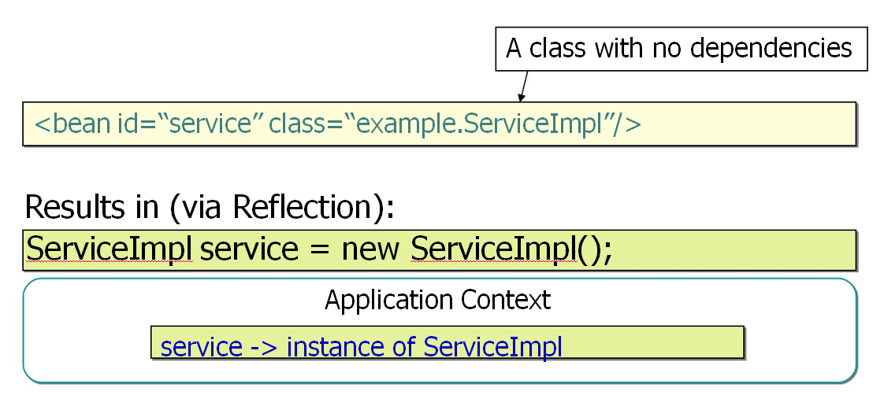
Simplest Possible Bean Definition

Slide 19
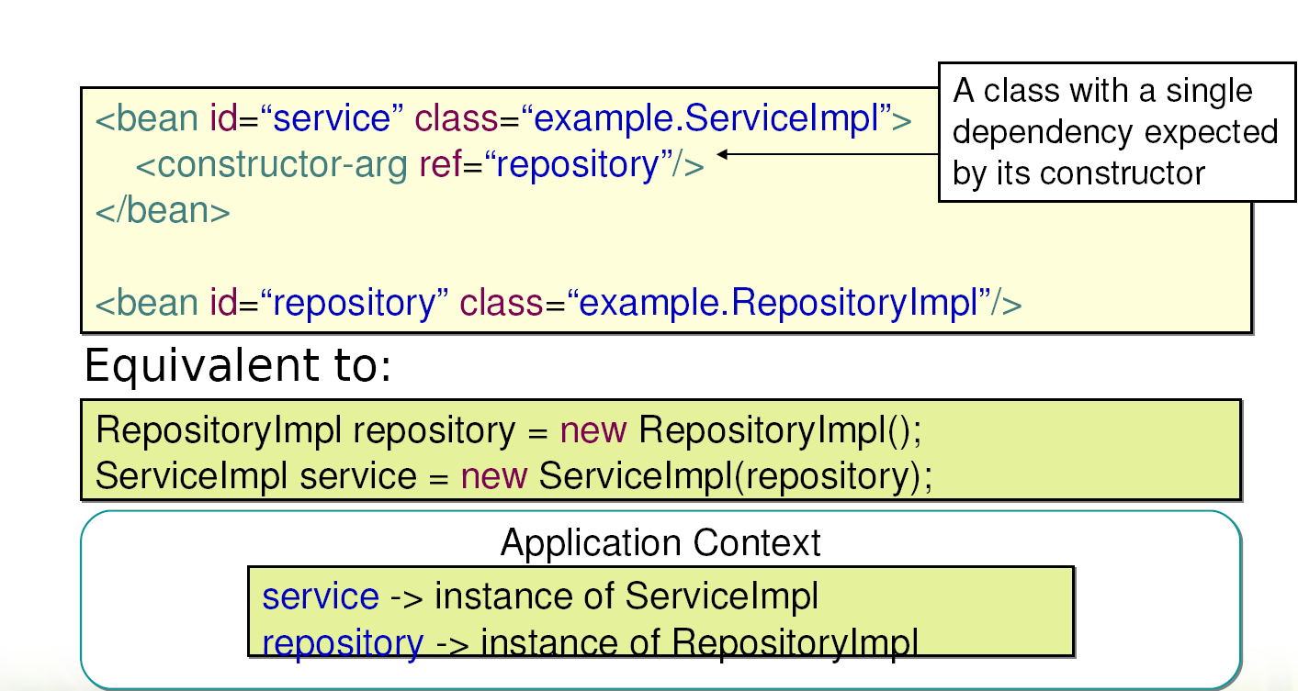
Constructor Dependency Injection

Slide 20
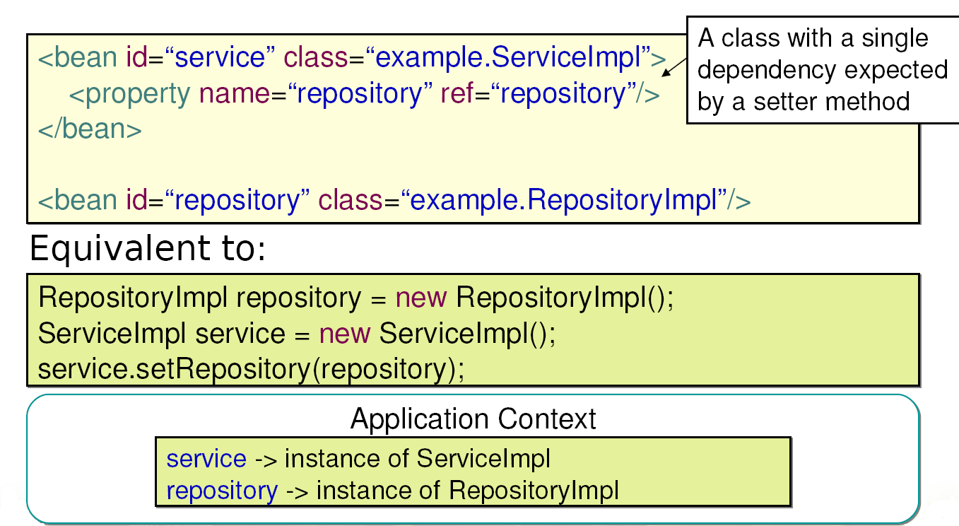
Setter Dependency Injection

Slide 21
When to Use Constructors vs. Setters?
Spring supports both
You can mix and match
Constructor
Enforce mandatory dependencies
Promote immutability
Concise for programmatic usage
Setter
Have descriptive names
Follow JavaBean™ conventions
Inherited automatically

Slide 22
General Recommendations
Follow standard Java design guidelines
Use constructors to set required properties
Use setters for optional or those with default values
You may find some classes are designed for a particular injection strategy
In that case go with it, do not fight it
Be consistent above all

Slide 23
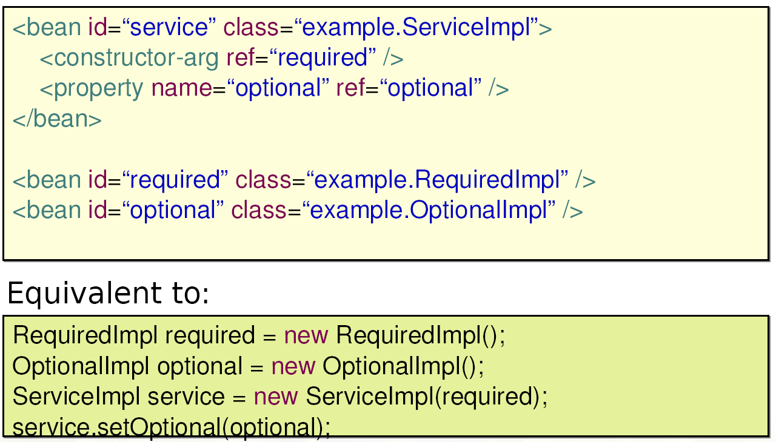
Combining Constructor/Setter Injection

Slide 24
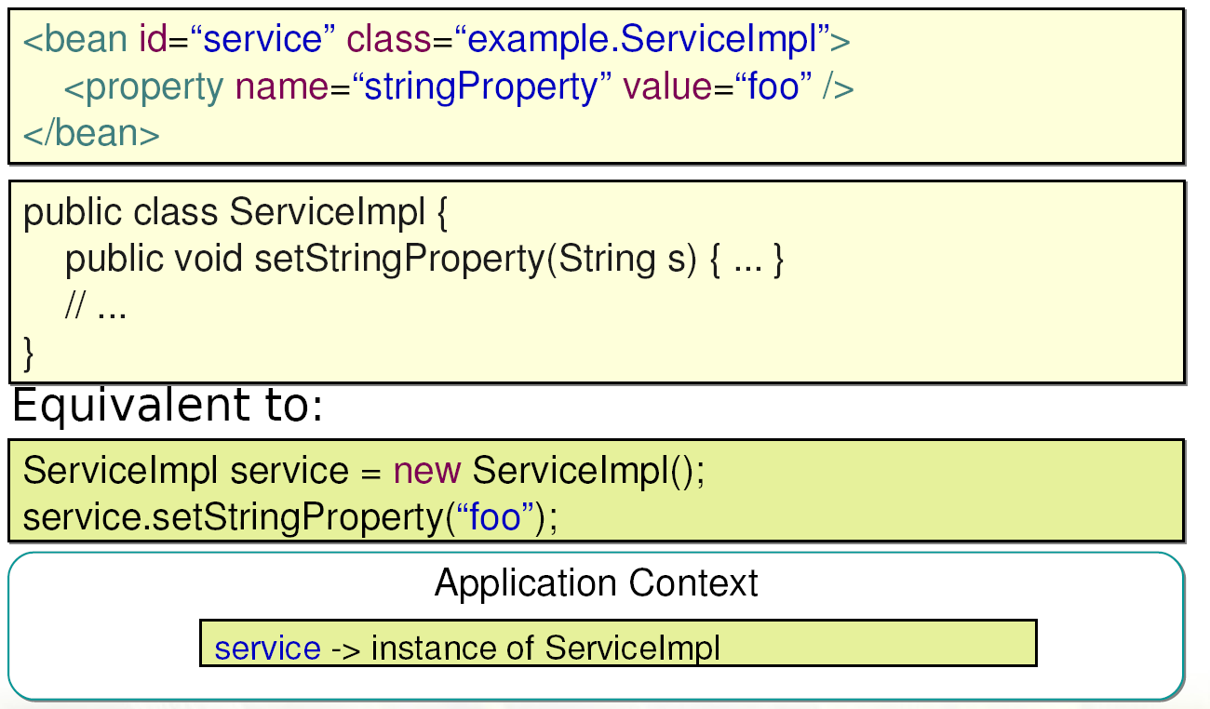
Injecting Scalar Values

Slide 25
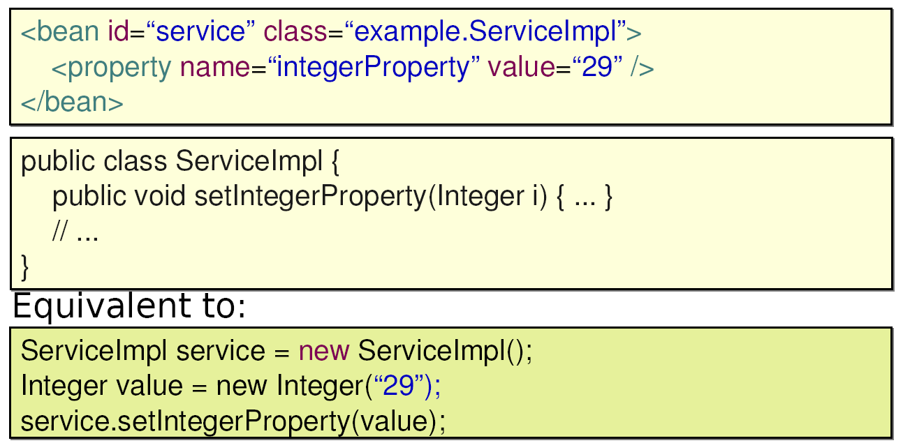
Automatic Value Type Conversion

Slide 26
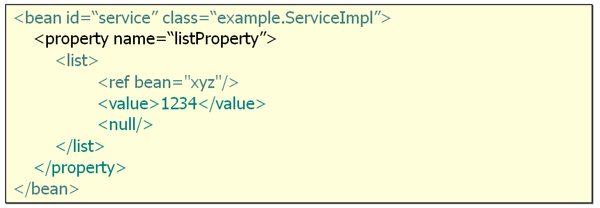
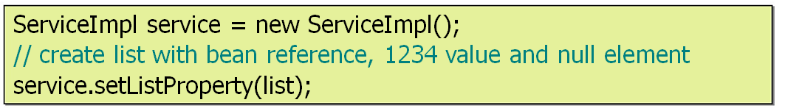

Injecting lists
Equivalent to:

Slide 27
Injecting collections
Similar support available for
Properties (through props / prop elements)
Set (through a set element, similar to list)
Map (through map / key elements)

Slide 28
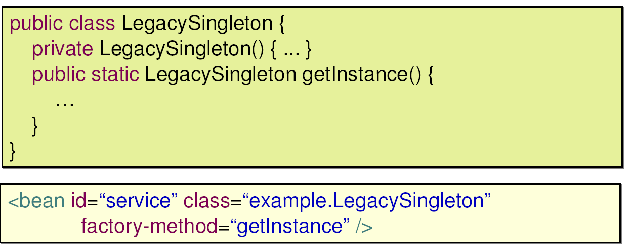
Calling Factory Methods
Some objects cannot be created by a constructor

Slide 29
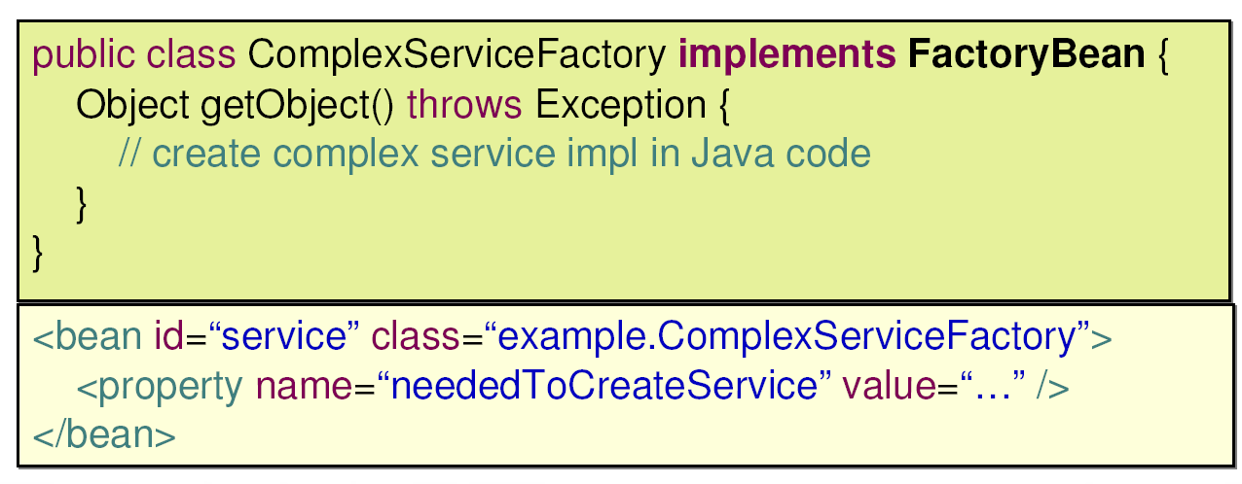
Calling Factory Beans
Sometimes you want Spring to always delegate to Java code to create another bean

Slide 30
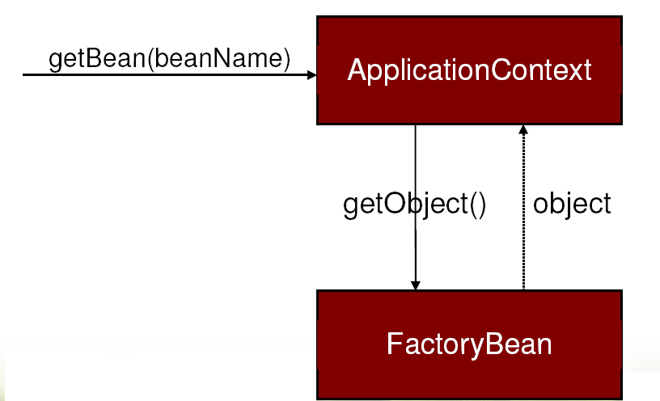
The FactoryBean Contract
Spring auto detects any bean that implements FactoryBean and returns the object created by getObject() to clients
The factory itself is concealed

Slide 31
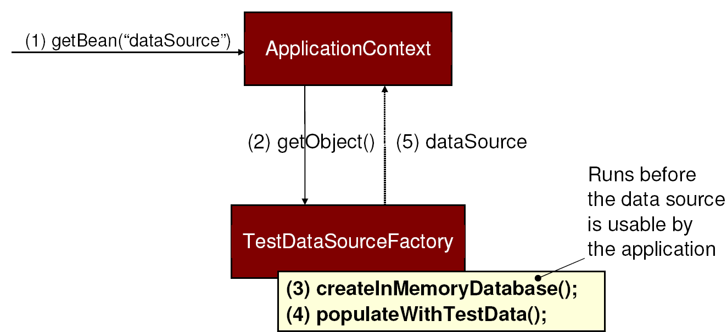
A Good Factory Bean Example
Encapsulating the creation of a test DataSource

Slide 32
FactoryBeans in Spring
JndiObjectFactoryBean
One option for looking up JNDI objects
FactoryBeans for creating remote proxies
FactoryBeans for configuring data access technologies like Hibernate, JPA or iBatis

Slide 33
Creating a Spring Application Context
Spring application contexts can be bootstrapped in any environment, including
JUnit system test
Web application
Enterprise Java Bean (EJB)
Standalone application
Loadable with bean definitions from files
In the class path
On the local file system
At an environment-relative resource path

Slide 34
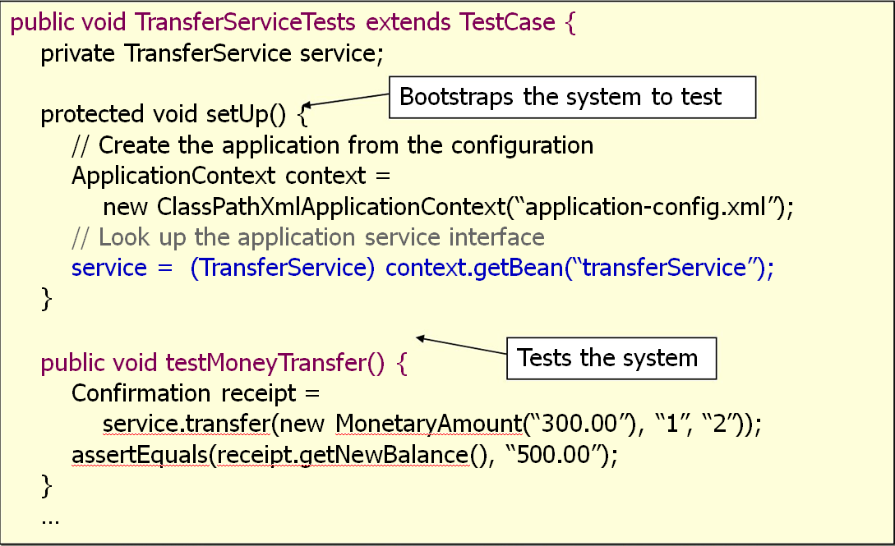
Example: Using an Application Context Inside a Junit System Test

Slide 35
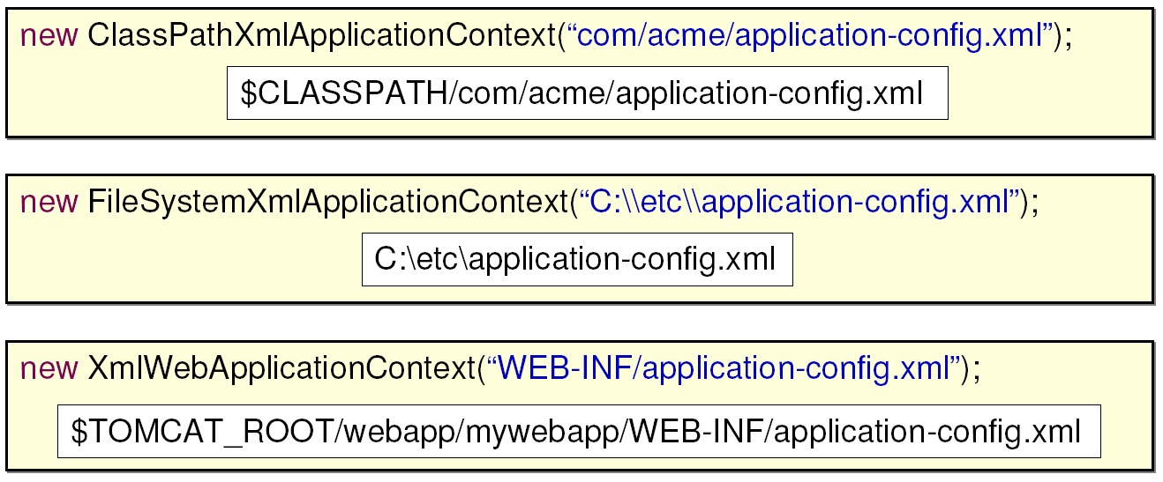
Spring's Flexible Resource Loading Mechanism
ApplicationContext implementations have default resource loading rules

Slide 36
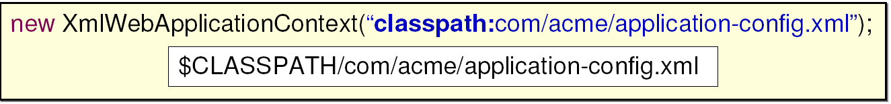
Spring's Flexible Resource Loading Mechanism (2)
However, default rules can be overridden with resource loading prefixes
These prefixes can be used anywhere Spring needs to deal with resources
Not just in constructor args to application context
Various prefixes
Classpath:
File:
http:

Slide 37
Creating a Spring Application Context from Multiple Files
A context can be configured from multiple files
Allows partitioning of bean definitions into logical groups
Generally a best practice to separate out “application” beans from “infrastructure” beans
Infrastructure often changes between environments
Evolves at a different rate

Slide 38
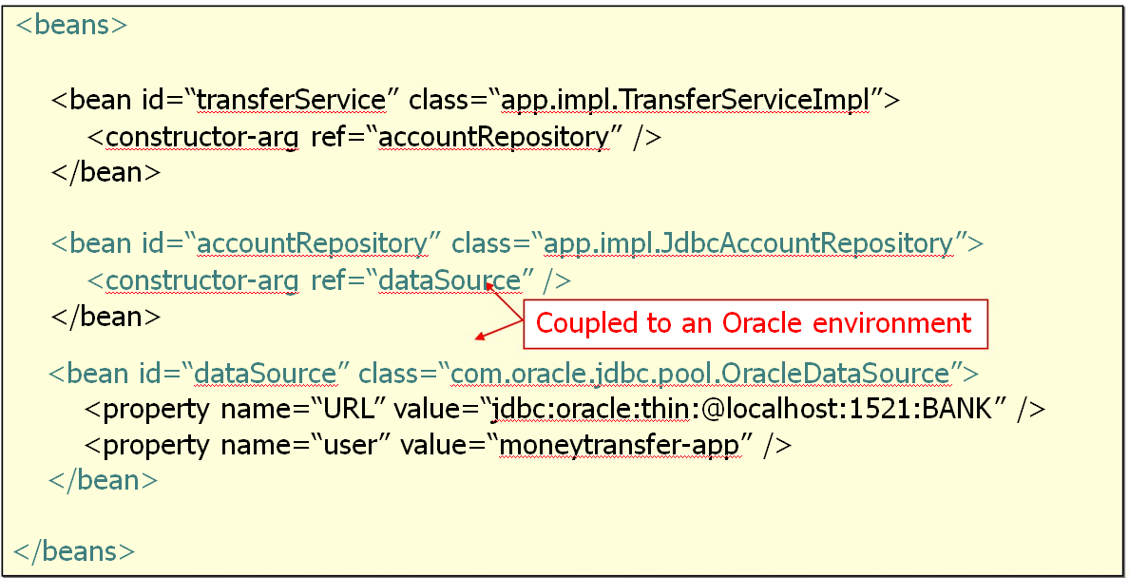
Mixed Configuration

Slide 39
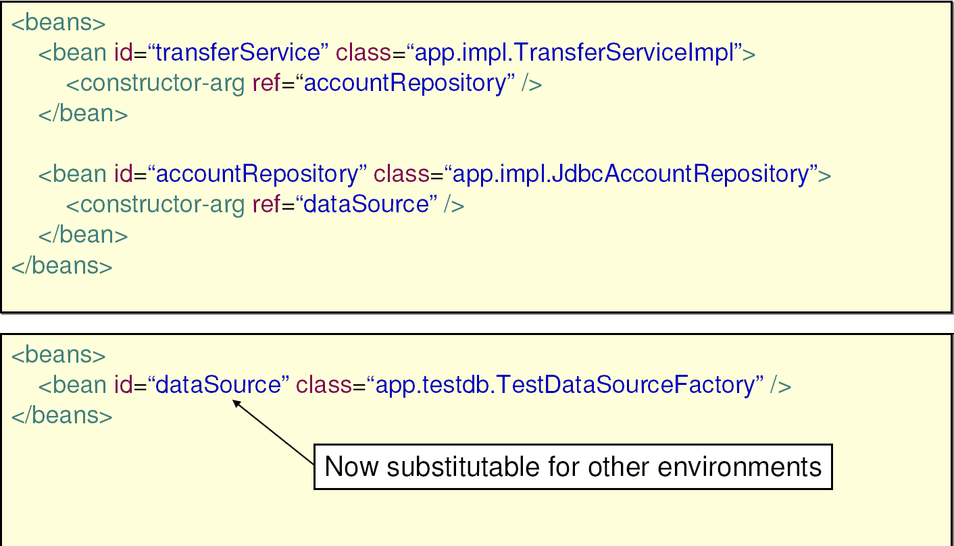
Partitioning Configuration

Slide 40
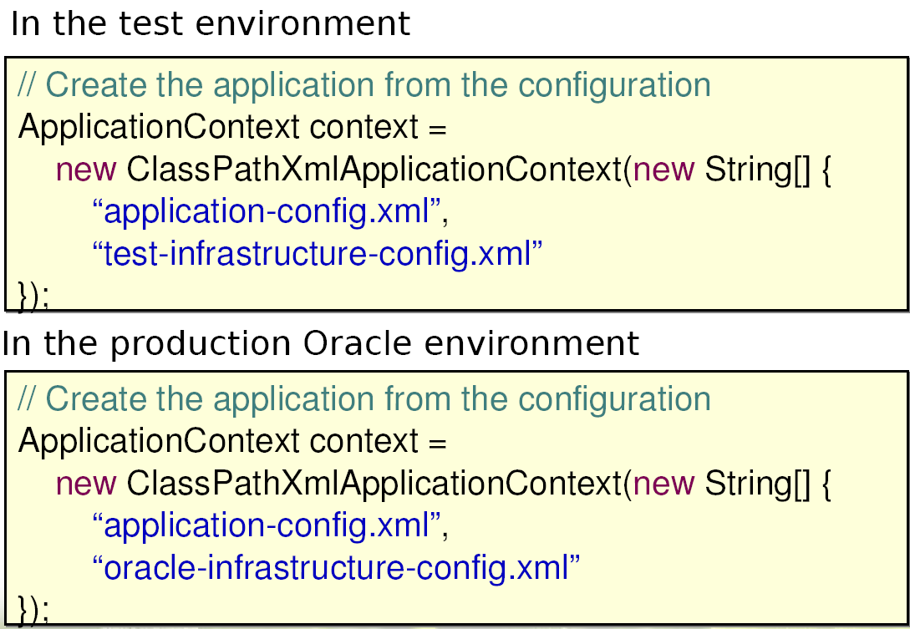
Bootstrapping in Each Environment

Slide 41
Benefits of Dependency Injection
Your object is handed what it needs to work
Frees your object from the burden of resolving its dependencies
Simplifies your code, improves code reusability
Promotes programming to interfaces
Conceals the implementation details of each dependency
Improves testability
Dependencies can be easily stubbed out for unit testing
Allows for centralized control over object lifecycle
Opens the door for new possibilities

Slide 42
LAB
Using Spring to configure an Application

Slide 43
Developing Aspects with Spring AOP
Aspect-Oriented Programming for
Declarative Enterprise Services

Slide 44
What Problem Does AOP Solve?
Aspect-Oriented Programming (AOP) enables modularization of cross-cutting concerns
Generic functionality that is needed in many places in your application
Examples
Logging and Tracing
Transaction Management
Security
Caching
Error Handling
Performance Monitoring
Custom Business Rules

Slide 45
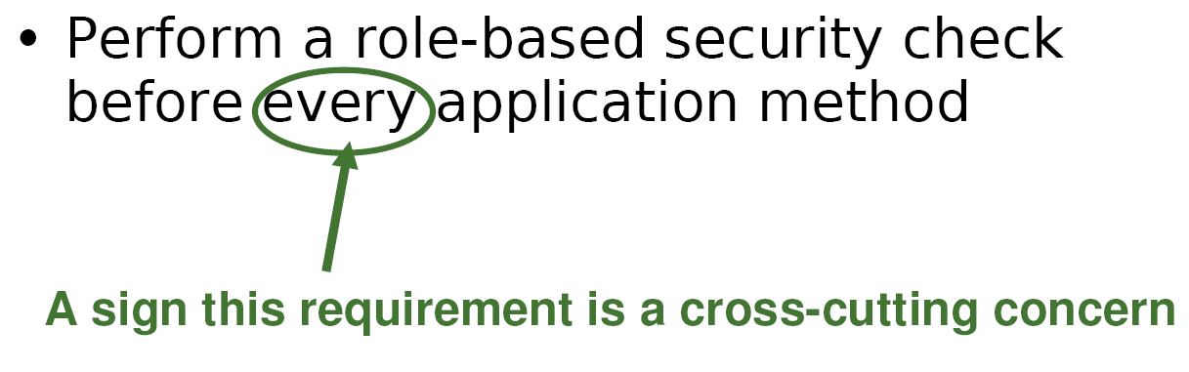
An Example Requirement

Slide 46
Implementing Cross Cutting Concerns Without Modularization
Failing to modularize cross-cutting concerns leads to two things
Code tangling
A coupling of concerns
Code scattering
The same concern spread across modules

Slide 47
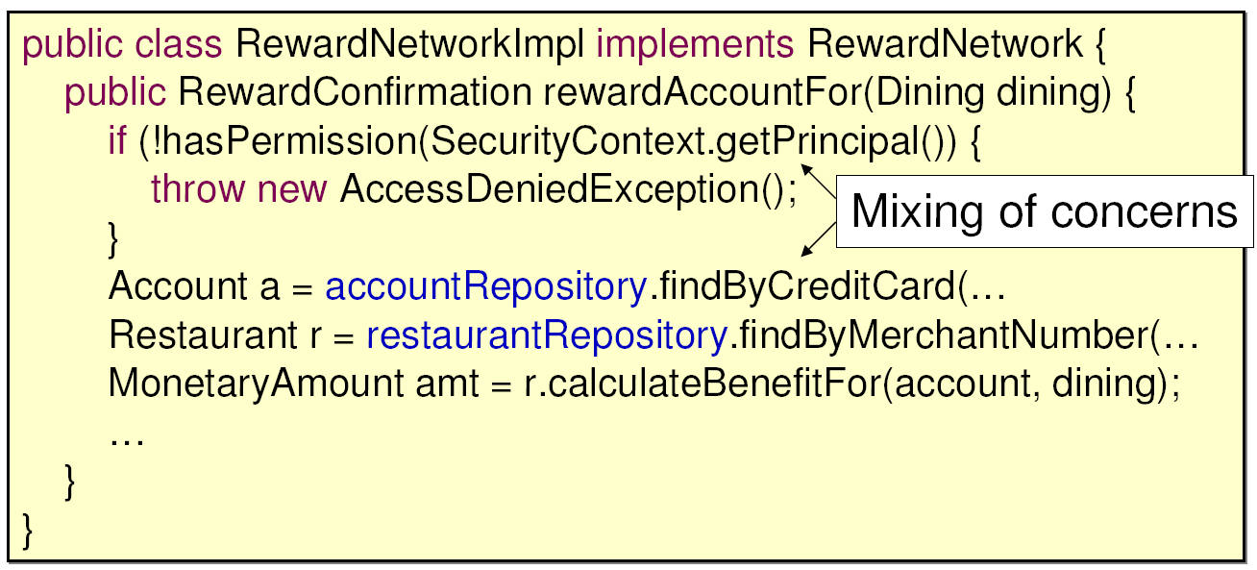
Symptom #1: Tangling

Slide 48
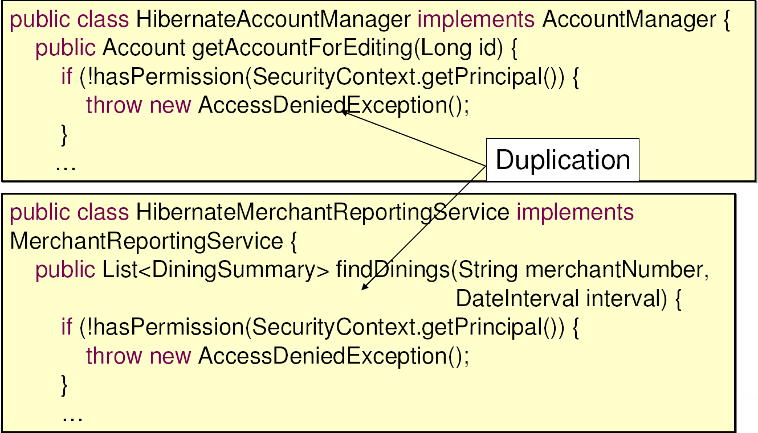
Symptom #2: Scattering

Slide 49
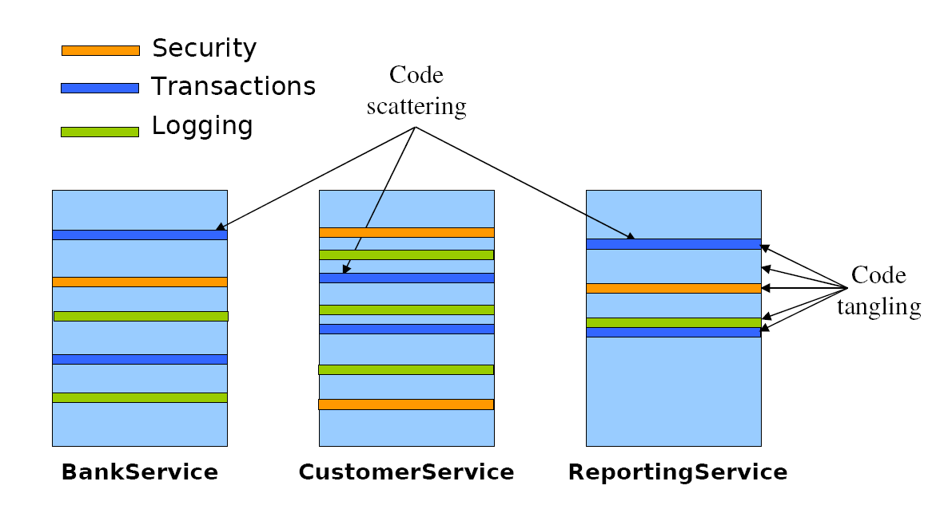
System Evolution Without Modularization

Slide 50
Aspect Oriented Programming (AOP)
Aspect-Oriented Programming (AOP) enables modularization of cross-cutting concerns
To avoid tangling
To eliminate scattering

Slide 51
How AOP Works
Implement your mainline application logic
Focusing on the core problem
Write aspects to implement your cross-cutting concerns
Spring provides many aspects out-of-the-box
Weave the aspects into your application
Adding the cross-cutting behaviours to the right places

Slide 52
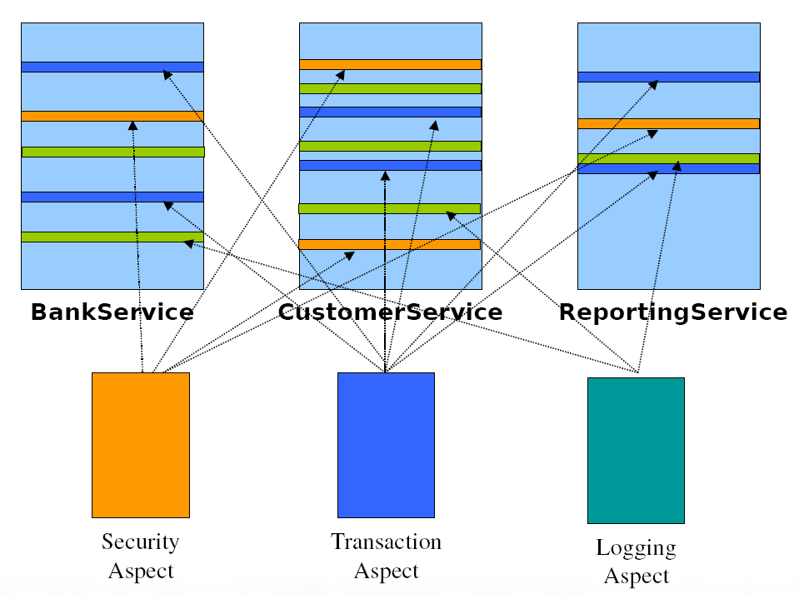
System Evolution: AOP based

Slide 53
Leading AOP Technologies
AspectJ
Original AOP technology (first version in 1995)
Offers a full-blown Aspect Oriented Programming language
Uses byte code modification for aspect weaving
Spring AOP
Java-based AOP framework with AspectJ integration
Uses dynamic proxies for aspect weaving
Focuses on using AOP to solve enterprise problems
The focus of this session

Slide 54
Core AOP Concepts
Join Point
A point in the execution of a program such as a method call or field assignment
Pointcut
An expression that selects one or more Join Points
Advice
Code to be executed at a Join Point that has been selected by a Pointcut
Aspect
A module that encapsulates pointcuts and advice

Slide 55
AOP Quick Start
Consider this basic requirement
How can you use AOP to meet it?

Slide 56
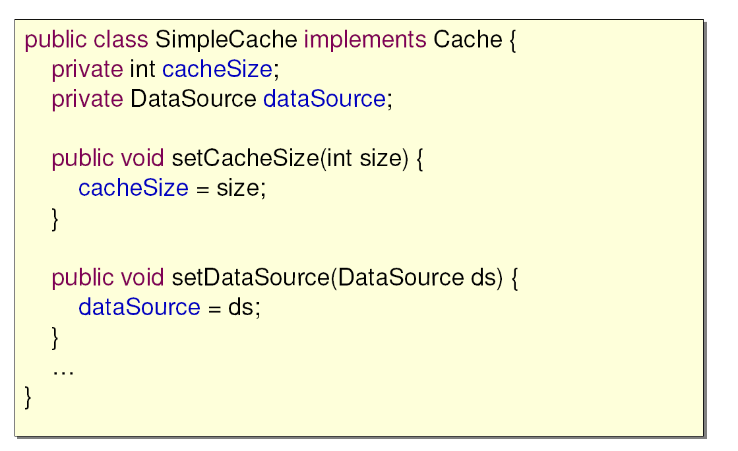
An Application Object Whose Properties Could Change

Slide 57
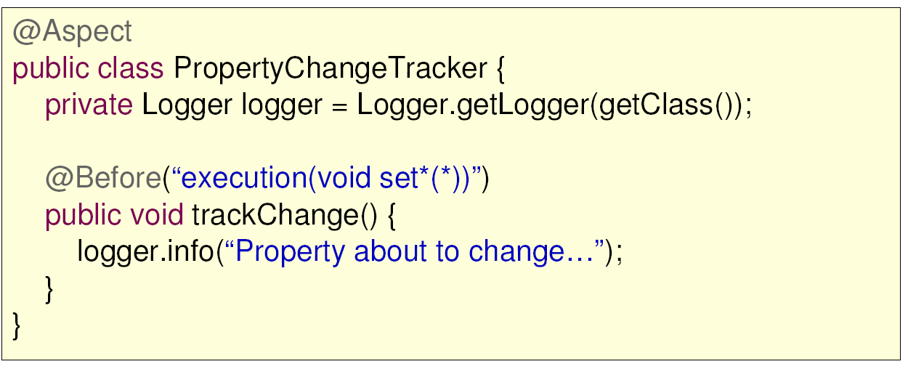
Implement the Aspect

Slide 58
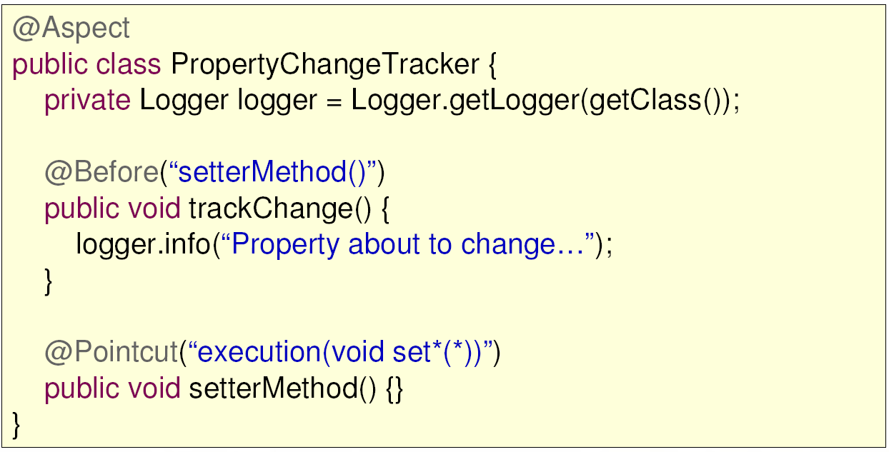
Best Practice – Use Named Pointcuts

Slide 59
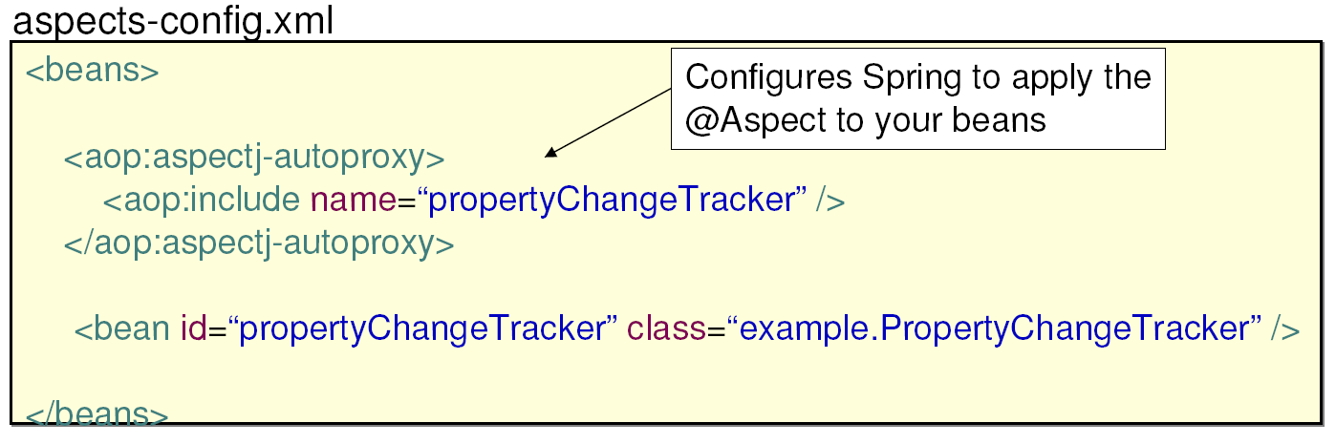
Configure the Aspect as a Bean

Slide 60
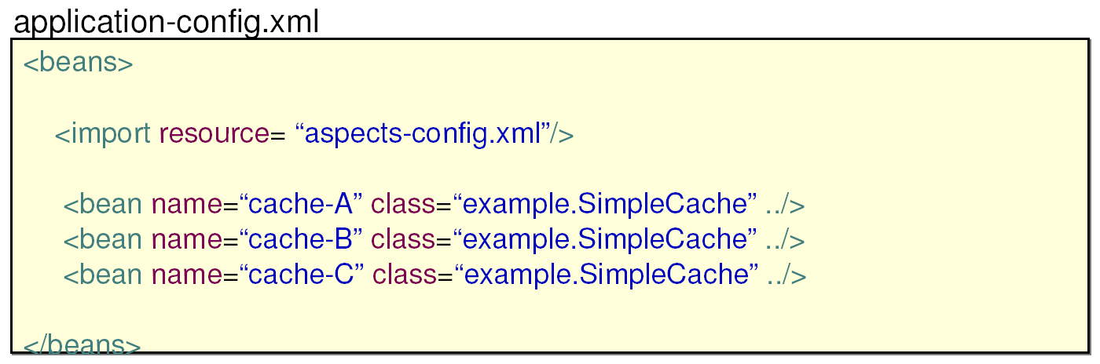
Include the Aspect Configuration

Slide 61
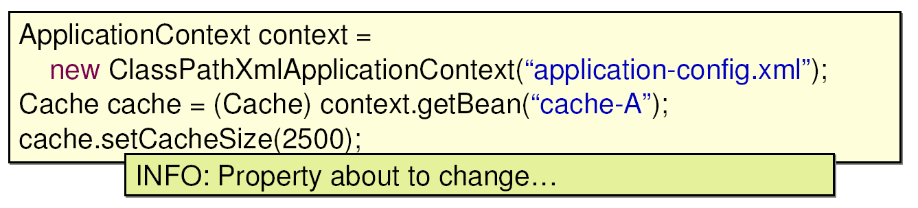
Test the Application

Slide 62
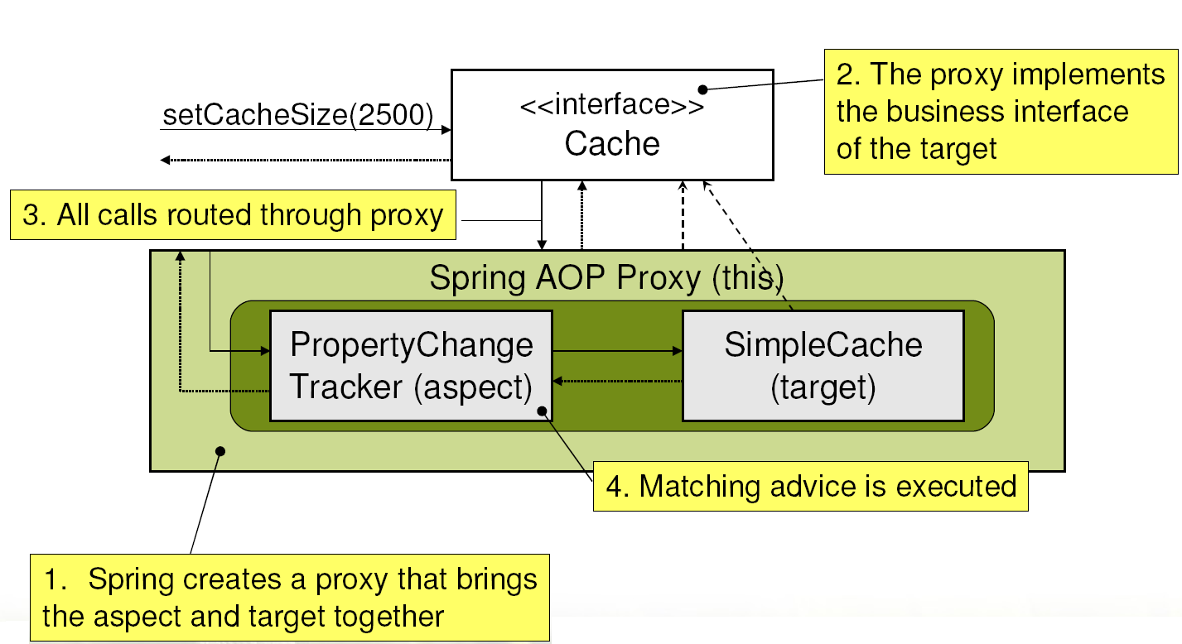
How Aspects are Applied

Slide 63
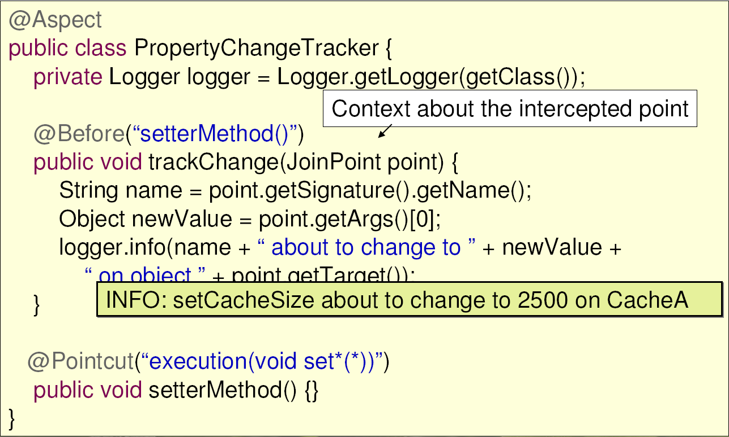
Tracking Property Changes – With Context

Slide 64
Useful JoinPoint Context
this
The currently executing object that has been intercepted (a proxy in Spring AOP)
target
The target of the execution (typically your object)
args
The method arguments passed to the join point
signature
The method signature of the join point

Slide 65
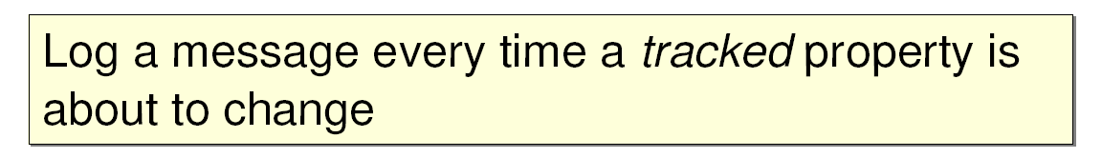
Extending the Example
Consider this extended requirement

Slide 66
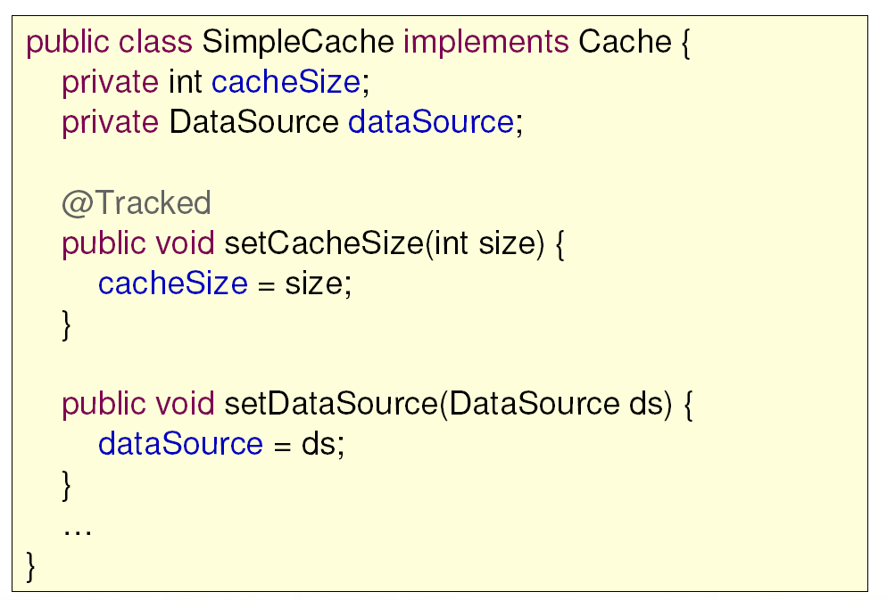
A @Tracked Property

Slide 67
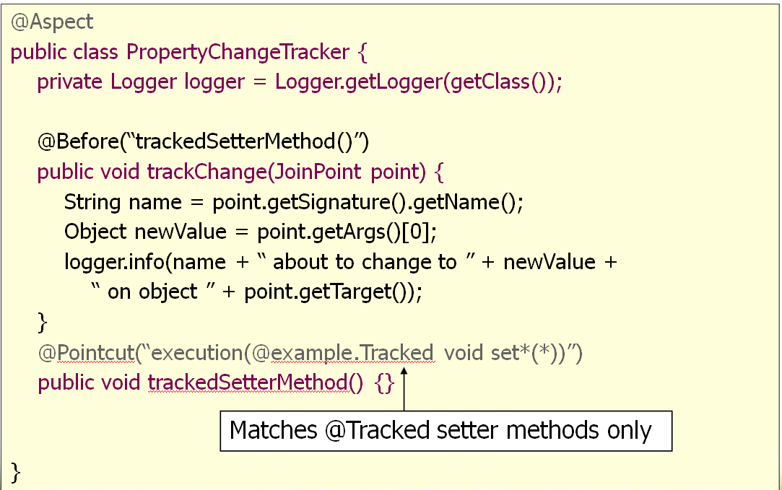
Logging @Tracked Property Changes

Slide 68
Defining Pointcuts
With Spring AOP you write pointcuts using AspectJ’s pointcut expression language
For selecting where to apply advice
Complete expression language reference available at
http://www.eclipse.org/aspectj

Slide 69
Common Pointcut Designator
execution(<method pattern>)
The method must match the pattern
Can chain together to create composite pointcuts
&& (and), || (or), ! (not)
Method Pattern
[Modifiers] ReturnType [ClassType] MethodName ([Arguments]) [throws ExceptionType]

Slide 70
Execution Expression Examples
execution(void send*(String))
Any method starting with send that takes a single String parameter and has a void return type
execution(* send(int, ..))
any method named send whose first parameter is an int (the “..” signifies 0 or more parameters may follow)
execution(void example.MessageService+.send(*))
any MessageService method named send that takes a single parameter and returns void

Slide 71
Execution Expression Examples using Annotations
Execution( @org.springframework.transaction.annotation.Transactional void *(..))
Any method marked with the @Transactional annotation
execution((@privacy.Sensitive *) *(..))
Any method that returns a value marked with the @Sensitive annotation

Slide 72
Context Selecting Pointcuts
Pointcuts may also select useful join point context
The currently executing object (proxy)
The target object
Method arguments
Annotations associated with the method, target, or arguments
Allows for simple POJO advice methods
Alternative to working with a JoinPoint object directly

Slide 73
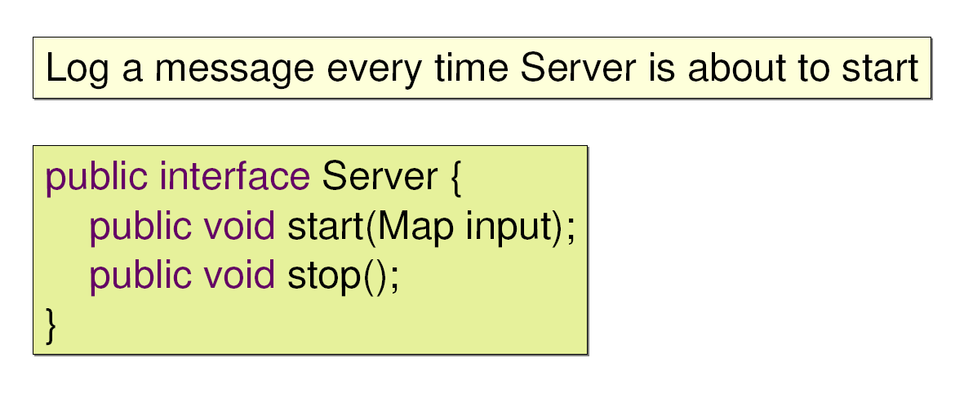
Context Selecting Example
Consider this basic requirement

Slide 74
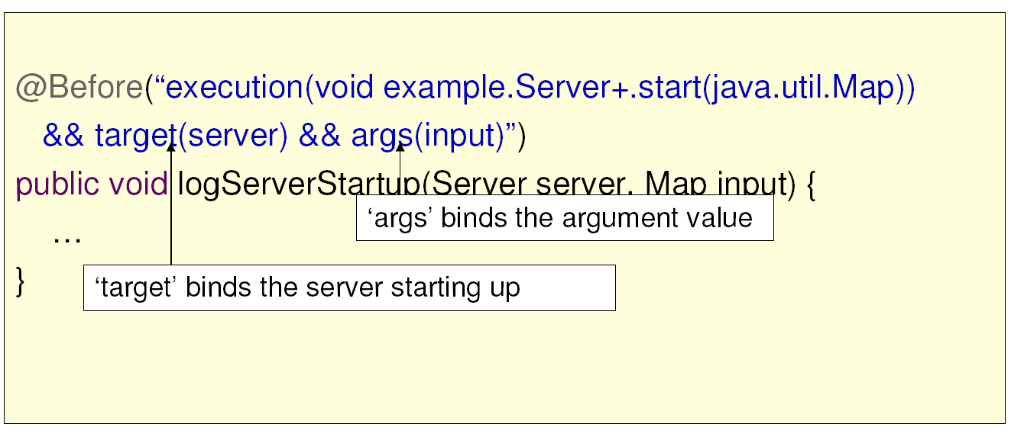
Logging Server Startup Attempts Context Selection - Anonymous Pointcut

Slide 75
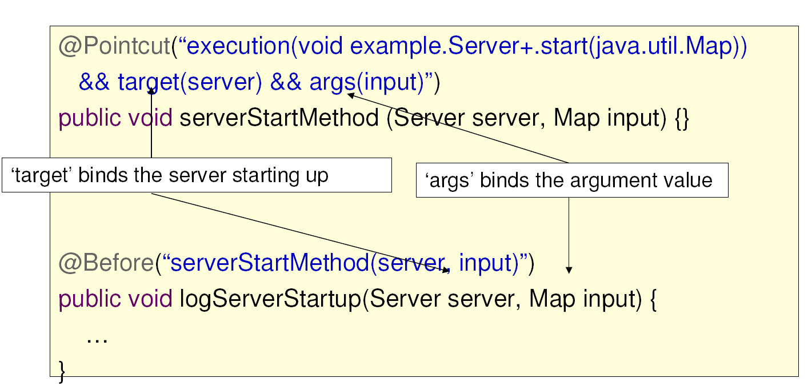
Context Selection – Named Pointcut

Slide 76
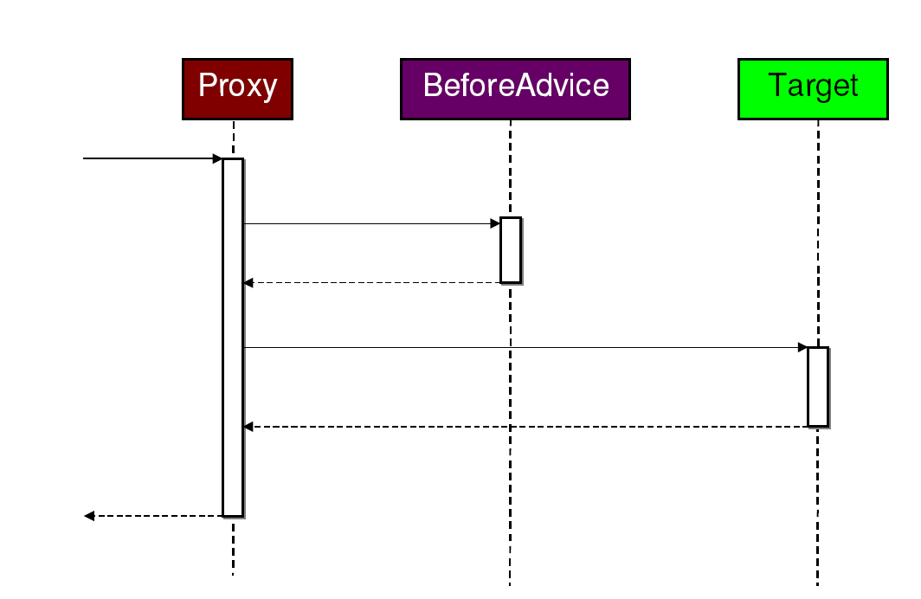
Advice Types: Before

Slide 77
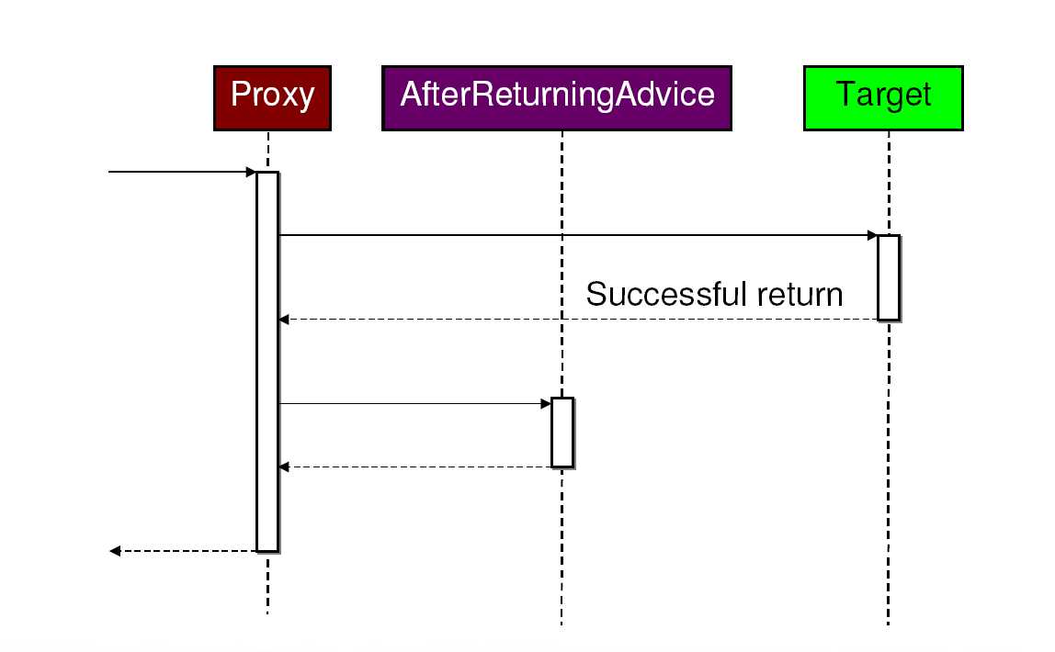
Advice Types: After Returning

Slide 78
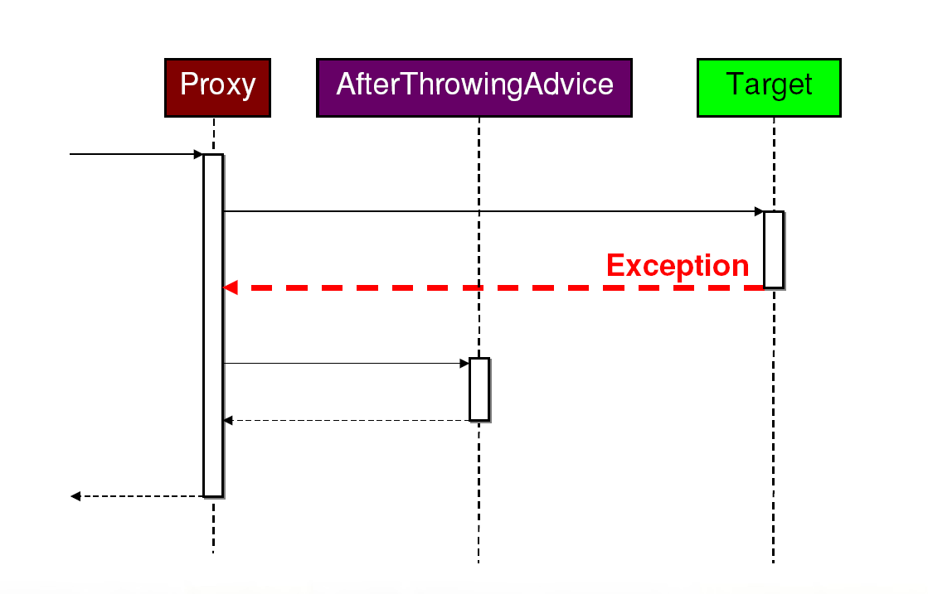
Advice Types: After Throwing

Slide 79

Advice Types: After

Slide 80

Advice Types: Around

Slide 81

Before Advice Example

Slide 82

Before Advice Example

Slide 83

After Returning Advice - Example

Slide 84

Example: After Throwing Advice

Slide 85
Advice Best Practices
Use the simplest possible advice that can work
Do not use @Around unless you must
Use strongly-typed context when possible
Instead of getting context data from the join point object

Slide 86
Alternative Spring AOP Syntax - XML
Annotation syntax is Java 5+ only
XML syntax works on Java 1.4
Approach
Aspect logic defined Java
Aspect configuration in XML
Easy to learn once annotation syntax is understood

Slide 87

Tracking Property Changes - Java Code

Slide 88

Tracking Property Changes - XML Configuration

Slide 89
Summary
Aspect Oriented Programming (AOP) modularizes cross-cutting concerns
An aspect is a module containing crosscutting behavior
Behavior is implemented as “advice”
Pointcuts select where advice applies
The three advice types are before, after, and around
Aspects are defined in Java with annotations or XML configuration

Slide 90
LAB
Developing Aspects with Spring AOP

Slide 91
Testing Spring Applications
Unit Testing without Spring,
and Integration Testing with Spring

Slide 92
What is TDD
TDD = Test Driven Development
Is it writing tests before the code? Is it writing tests at the same time as the code?
That is not what is most important
Do not get hung up on terminology
Ultimately, TDD is about writing automated tests that verify code actually works

Slide 93
“But I Don’t Have Time to Write Tests!”
Every development process includes testing
Either automated or manual
Automated tests result in a faster development cycle overall
Compare the time required to run a test in your IDE (seconds) vs. the time required for someone to manually follow a script (typically minutes/hours)

Slide 94
TDD and Agility
Comprehensive test coverage provides confidence
Confidence enables refactoring
Refactoring is essential to agile development

Slide 95
TDD and Design
Testing makes you think about your design
If your code is hard to test then the design should be reconsidered

Slide 96

Benefits of Continuous Integration
The cost to fix a bug grows exponentially in proportion to the time before it is discovered
Continuous Integration (CI) focuses on reducing the time before the bug is discovered
Effective CI requires automated tests

Slide 97
Unit Testing vs. Integration Testing
Unit Testing
Tests one unit of functionality
Keeps dependencies minimal
Isolated from the environment (including Spring)
Integration Testing
Tests the interaction of multiple units working together
Integrates infrastructure

Slide 98
Unit Testing
Verify a unit works in isolation
If A depends on B, A’s tests should not fail because of a bug in B
A’s test should not pass because of a bug in B
Stub or mock out dependencies if needed
Have each test exercise a single scenario
A path through the unit

Slide 99

Example Unit to be Tested

Slide 100

Implementing a Stub

Slide 101

Testing with a Stub

Slide 102
Stub Considerations
Advantages
Easy to implement and understand
Reusable
Disadvantages
A change to the interface requires the stub to be updated
Your stub must implement all methods, even those not used by a specific scenario

Slide 103
Steps to Testing with a Mock
Use a mocking library to generate a mock object
Implements the dependent interface on-the-fly
Record the mock with expectations of how it will be used for a scenario
What methods will be called
What values to return
Exercise the scenario
Verify mock expectations were met

Slide 104
The Easy Mock Library
EasyMock 2.0 is a popular mocking library
Used extensively in Spring for unit testing
What is taught in this course

Slide 105

Example - Testing with EasyMock
On setup
• Create mock(s)
• Create unit
For each test
• Record expected
method calls and set mock return values
• Call replay
• Exercise test scenario
• Call verify

Slide 106
Mock Considerations
Advantages
No additional class to maintain
You only need to setup what is necessary for the scenario you are testing
Allows visibility to unit internals if you want (verifying that expectations were met)
Disadvantages
A little harder to understand at first

Slide 107
Mocks or Stubs?
You will probably use both
General recommendations
Favor mocks for non-trivial interfaces
Use stubs when you have simple interfaces with repeated functionality
Always consider the specific situation
Read “Mocks Aren’t Stubs” by Martin Fowler
http://www.martinfowler.com/articles/mocksArentStubs.html

Slide 108
Integration Testing
Tests the interaction of multiple units
Tests application classes in the context of their surrounding infrastructure
Infrastructure may be “scaled down”

Slide 109
Spring’s Integration Test Support
Located in spring-test.jar
Consists of several JUnit test support classes
Central support class is
AbstractDependencyInjectionSpringContextTests
Extends JUnit TestCase
Loads system test configuration from one or more XML bean definition files
Caches a shared ApplicationContext across multiple test methods
Resolves test dependencies

Slide 110

Using Spring’s Integration Test Support

Slide 111

Test Case Setup (first time only)

Slide 112

Using Spring 2.5 with JUnit 4

Slide 113
Benefits of Integration Testing with Spring
No need to deploy to an external container to test application functionality
Run everything quickly inside your IDE
Allows reuse of your configuration between test and production environments
Application configuration logic is typically reused
Infrastructure configuration is environment-specific
DataSources
JMS Queues

Slide 114
Summary
Testing is an essential part of any development
Unit testing tests a class in isolation where external dependencies should be minimized
Consider creating stubs or mocks to unit test
You don’t need Spring to unit test
Integration testing tests the interaction of multiple units working together
Spring provides good integration testing support

Slide 115
LAB
Testing Spring Applications

Slide 116
Annotation-Based Dependency Injection
Introducing Spring’s Annotations for
Dependency Injection

Slide 117

How Spring Works

Slide 118

The Approach You’re Used to

Slide 119

The Approach You’re Used to

Slide 120

The Annotation-Based Approach

Slide 121

The Annotation-Based Approach

Slide 122

Usage - Nothing Changes!

Slide 123
Quick Start Summary
Spring container needs POJOs and wiring instructions to assemble your application
Wiring instructions can be provided in XML…
…but also using annotations…
…or a combination of the two

Slide 124
Configuration Annotations
@Autowired
@Resource
@Component / @Repository
@PostConstruct / @PreDestroy / @Required
As shown earlier

Slide 125

@Autowired
Asks Spring to autowire fields, methods or constructors by using the type
Removes the need to specify constructor-arg or property elements in XML
Methods and constructors can have multiple arguments that will all be injected

Slide 126

@Autowired Works For Collections Too!
Just include a typed Collection to obtain a reference to all beans of a certain type

Slide 127


Optional @Autowiring
Using the required element, specify whether or not Spring should fail if no instance was found
Defaults to true
Provides nice way of specifying defaults

Slide 128

Disambiguation with @Autowired
Although not often needed, @Autowired provides disambiguation features
Needed in case multiple instances of the same type exist, one of which needs to be autowired
Using an @Qualifier annotation you can inject named beans

Slide 129

@Resource ("myBeanName")
JSR-250 annotation (not Spring-specific)
Tells Spring to inject a bean identified by the given name
Useful in case there are two beans with the same type and autowiring does not work
Works for all methods (not just setters)
Can also lookup JNDI references

Slide 130

For these Annotations to Work…
We need to ‘enable them’

Slide 131

@Component
Identifies POJOs as Spring Beans
Removes the need to specify almost anything in XML
Optionally pass it a String, which will be the bean name
Default bean name is de-capitalized non-qualified name

Slide 132

@Component and names
@Component takes a String that names the bean
Arguably not a best practice to put bean names in your Java code

Slide 133

For This Annotation To Work…
We need to enable ‘component scanning’
Auto-enables <context:annotation-config/>

Slide 134

@Scope
@Scope allows you to customize the instantiation strategy to 'prototype', 'request', 'session' or any other (possibly custom) scope

Slide 135

@Component Is A Meta-Annotation
Allows introduction of custom annotation being picked up by the component scanner

Slide 136

Including & Excluding Beans
Using filters, we can include or exclude beans,
based on type or class-level annotation

Slide 137
When use what?
Start using annotations for small isolated parts of your application (Spring @MVC controllers)
Annotations are spread across your code base
XML is centralized in one (or a few) places
XML for infrastructure and more 'static' beans
Annotations for frequently changing beans
Spring IDE does not (yet) fully support @Autowired and @Component

Slide 138

JUnit 4 and the @Test Annotation
JUnit 4 does not use inheritance and methods that have to be prefixed with test
Instead you have to annotate test methods with @Test

Slide 139

System Testing with JUnit 4
Annotate the test with @ContextConfiguration
Optionally pass a String-array of config locations using the locations property (by default Spring loads config.xml from the same package)
Use @Autowired annotations as before

Slide 140

Transactional Tests
The super class is gone, so there’s no transaction managed tests anymore by default
Annotate test method (or type) with @Transactional and they’ll be run in a transaction that will be rolled back afterwards

Slide 141
Summary
Spring’s configuration directives can be written in XML or using annotations
You can mix and match XML and annotations as you please
@Autowired and @Component allow for almost empty configuration files
@Transactional and @ContextConfiguration allow you to run transactional system tests

Slide 142
LAB
Using Spring’s annotations to Configure and
test an application

